Slide 1

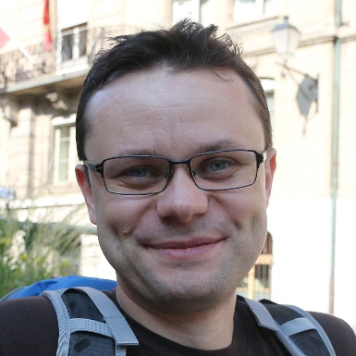
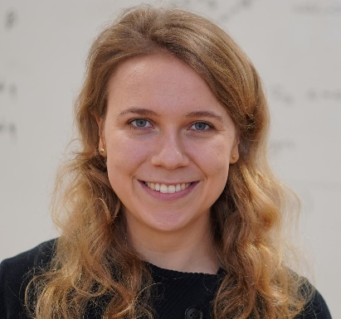
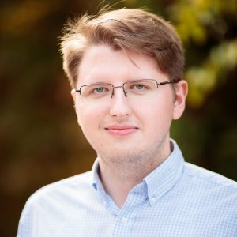

Proofs are Programs Winter 2024-25 @ Ruhr Uni Bochum
Lecturers: Cătălin Hrițcu and Clara Schneidewind
TAs: Cezar Andrici and Sebastian Harwig
Max Planck Institute for Security and Privacy (MPI-SP)

Slide 2

This course in a nutshell
Logic and proofs
Verifying functional programs
Formalizing simple imperative language
Secure information flow
Using the Coq proof assistant
gentle introduction to both functional programming and formal proofs (both in Coq)
["Le coq mécanisé" picture by Lilia Anisimova]

Slide 3

The Coq proof assistant
Developed at Inria in France since 1983 (in OCaml)
Coq helps you build formal proofs interactively
Proving in Coq is like programming
gamified, addictive, and lots of fun
if you like programming, you will also like Coq proofs
This helps you deeply understand proofs
In fact, formal Coq proofs are just purely functional programs
Curry-Howard correspondence: deep connection between logic and functional programming

Slide 4

Functional programming
Write computations as recursive functions
using recursion, immutable datatypes, and pattern matching
limit side-effects, such as mutating stateful data structures
Coq is purely functional = zero side-effects
all computations are mathematical functions (in particular terminating)
Functional programming languages like OCaml, Haskell, ...
not completely pure, but still try to reduce and control side-effects
they still make it as easy as possible to write functional code
Course previous semester using OCaml (again in couple of semesters)
Not a prerequisite for this course
Notes:
Explanation from preface: computation should be pure, in the sense that the only effect of execution should be to produce a result: it should be free from side effects such as I/O, assignments to mutable variables, redirecting pointers, etc

Slide 5

Functional Programming in practice
Functional languages have some practical success
Meta (OCaml, Haskell, Rust), Microsoft (OCaml, F#, F*, and Rust), X (Scala), Mozilla (Rust), Google (Rust), Amazon (Rust), Financial industry, Blockchains and smart contracts (Clara's group does research on this), ...
Not yet fully mainstream, but ...
Many cool ideas already adopted by mainstream languages:
Lambdas, Generics in Java/C#, Rust's type system, datatypes, pattern matching (most admired language on Stack Overflow for the last 11 years!)
Functional programmers often earn more (Stack Overflow developer survey)
Functional programs are concise, elegant, beautiful
This makes understanding and reasoning about programs much easier, both informally and formally
For this course this last point is very important
formal verification by proving theorems about purely functional programs in Coq

Slide 6
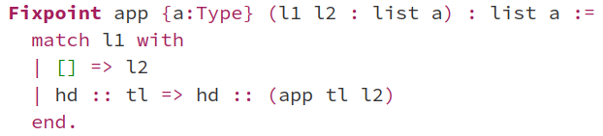
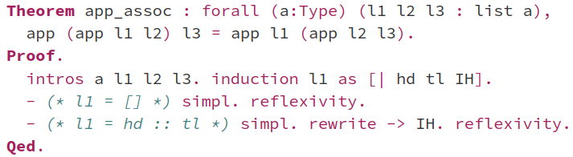
Coq proof that append is associative
Notes:
TODO: also show informal proof corresponding to this!

Slide 7
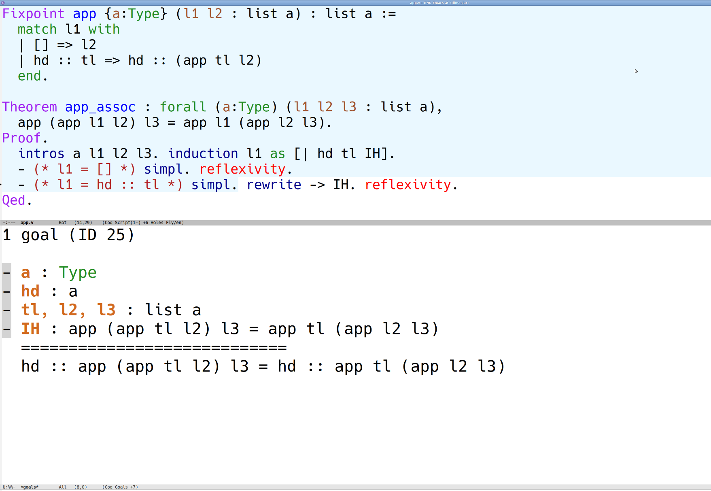

Slide 8
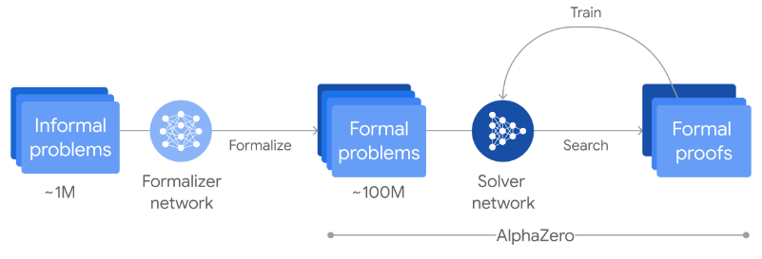
Machine-checked proofs of math theorems
The 4-color theorem
proved in 1976, simplified in 1996
proofs rely on a computer
infeasible for a human to check
initially not accepted by all mathematicians
mechanized in Coq by Georges Gonthier in 2005
Construction of perfectoid spaces (Peter Scholze, Lean community, 2020)
Mathlib math library for Lean has over 100,000 theorems, over 1,000,000 lines of code, and an active community including many mathematicians (e.g. Terence Tao)
AlphaProof: Google DeepMind AI achieves silver medalist level in IMO (2024)
Key ingredient: the Lean proof assistant checks each step of the AI
[World map from Wikipedia]
Notes:
4 color: no more than four colors are required to color the regions of any map so that no two adjacent regions have the same color
Feit-Thompson:
first major step in the classification of finite simple groups
states that every finite group of odd order is solvable
Saved slide space:
Odd order theorem (Feit-Thompson)
Coq proof from 2012 introduced the Mathematical Components library
Hales' proof of Kepler conjecture (HOL Light and Isabelle)

Slide 9
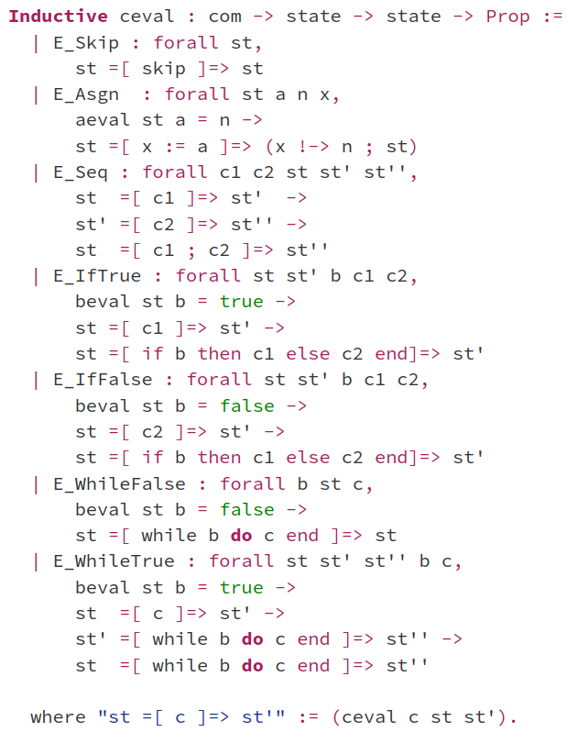
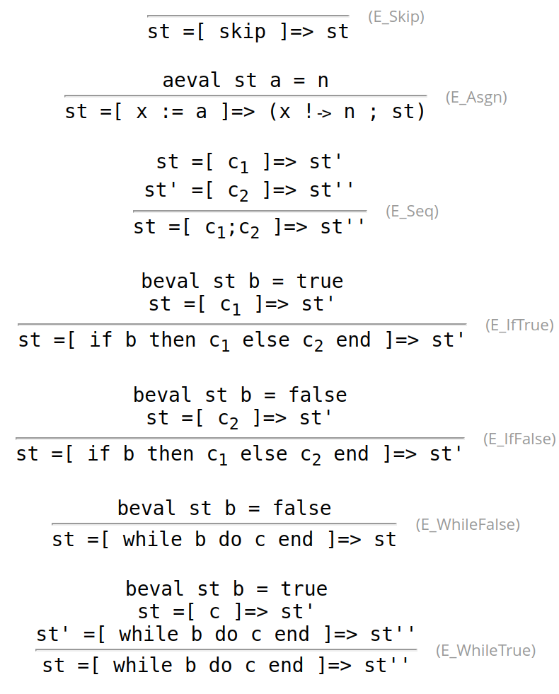
Formalizing simple imperative language

Slide 10
Why formalize programming languages?
CompCert C compiler verified in Coq to compile correctly
each language given a semantics
transformations and optimizations
implemented as pure functions
proved to preserve semantics
Cezar, Sebastian, Cătălin, et al building secure compilers in Coq and F*
including a secure variant of CompCert
a secure compiler from F* to OCaml
side-channel defenses, etc.

Slide 11
Secure information flow
initial state
public vars
secret vars
allowed flows
What does it mean that a program doesn't leak secrets?
Noninterference (for imperative programs):
secrets don't flow from secret variables to public variables
executing the program twice with different initial values for the secret variables produces two final states whose public variables are still equal
Can be enforced statically by simple type system
Prevent explicit flows (simple taint tracking): public := 2*secret + 1
Prevent implicit flows, via the control flow of the program: if secret=0 then public := 0 else public := 1
Can also be enforced dynamically
e.g. Secure Multi-Execution
public vars
secret vars
final state
initial state
dummy
secret vars
public vars
secret vars
public exec
secret exec
final state
public vars
secret vars

Slide 12
In this course you will learn ...
to write purely functional programs in Coq
natural numbers, lists, maps, trees, program syntax
to verify these programs by proving theorems about them
case analysis, induction, inversion, proof automation, ...
about the Curry-Howard correspondence (optional for BSc)
proofs = typed purely functional programs
to formalize a simple imperative programming language
syntax and operational semantics (evaluation derivations)
about secure information-flow
enforcing noninterference statically or dynamically
Notes:
TODO: a bit about imp + security too

Slide 13
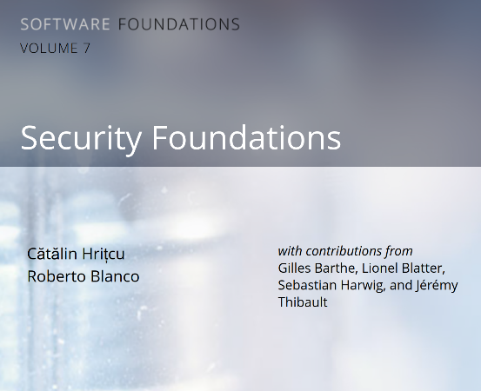
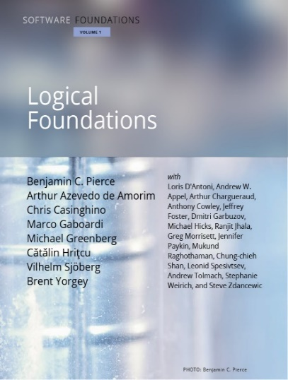
This course is very hands on
Coq is your personal proof assistant
Taking gamification to the next level!
Course based on two textbooks
lots of exercises in Coq
our Logical Foundations version available at: https://mpi-sp-pap-2024-25.github.io/book-lf
You will understand proving
It's not hard, it's just programming!
If you like programming, you will like formal proofs too!
Advice: ask questions, interact

Slide 14
Lecture logistics
14 lectures: roughly first 1/2 Clara, second 1/2 Cătălin
Vacation 21 Dec to 6 Jan, so no lecture, no tutorials
We hope for a mostly in-person course
So please attend physically whenever possible!
When you really cannot attend physically you can use Zoom or watch the recording
Notes:
TODO

Slide 15
Exercises
This is a very hands on course, so exercising strongly recommended
you will learn the most by writing programs and proofs in Coq
very strong correlation between exercise scores and exam scores
Exercises count for up to 20% of bonus points
not required to do the optional exercises; they don't count for grade
New exercise sheet will be released on Moodle after most courses
1(-2) Coq file(s) with holes you have to fill (basically 1-2 book chapters)
there will be around 10 exercise sheets in total
You have to turn in your solution on Moodle before next course
up to Wednesday at 23:59
Exercises are individual, please don't share solutions in any way!
Exercises highly recommended even if you're not taking this for credit

Slide 16
Tutorials: Q&A about the exercise sheets
TAs: Cezar Andrici and Sebastian Harwig
Wednesday 14:15-15:45
You can come and ask existing questions
Can also ask about old assignments, but solutions anyway on Moodle
You can also work on your own during tutorials
and ask questions as they arise
If you manage to solve an exercise sheet and don't have any questions, then no problem, you are not forced to come
Zoom participation in Q&A sessions possible (same Zoom room)
if you cannot make it in person, but in-person participants get priority
Notes:
TODO: update

Slide 17
Exams
Midterm exam (optional)
practice for the final exam
also written, on paper
duration: 60 minutes
bonus points: up to 10%
date: Thu, 28 November
time: 10:30-11:30
Final exam
written, on paper
so we will also teach you how to write down proofs informally
duration: 120 minutes
100% of the grade
date: 21 February
re-exam: 26 March

Slide 18
Credit and grade
CASA PhD students
attendance requirement is 50% of the exercises score
You can get credit if you study
Computer Science BSc and MSc
IT Security BSc* and MSc
*ITS BSc only as "free elective" (sorry!)
Mathematics MSc
Exercises (20% bonus)
Midterm (10% bonus)
Final exam (100%)
Adding up everything, you need 50% to pass and get credit,
and you need at least 95% to get highest grade

Slide 19

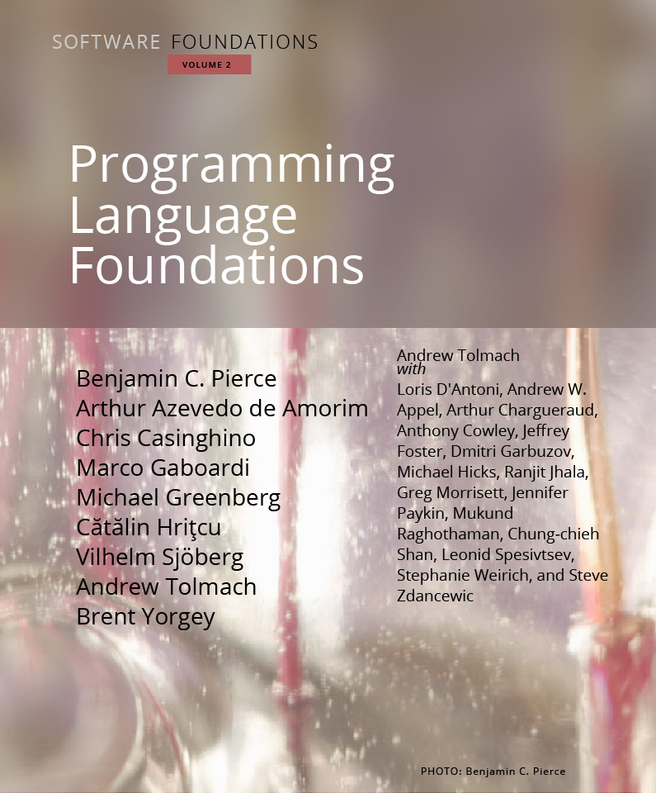

Follow up course next semester Foundations of Programming Languages, Verification, and Security

Slide 20


Foundations of ...
Programming Languages
formalize simple imperative and functional languages in Coq
type systems, program transformations, simple compilers
semantics, metatheory (e.g. type safety of the language)
Verification
Hoare Logic: verify imperative programs
against logical / functional specifications
Relational Hoare Logic: program equivalence and security
Security
Preventing timing side channels
for crypto code: constant time, speculative constant time
for arbitrary programs: relative security

Slide 21
Backup Slides

Slide 22
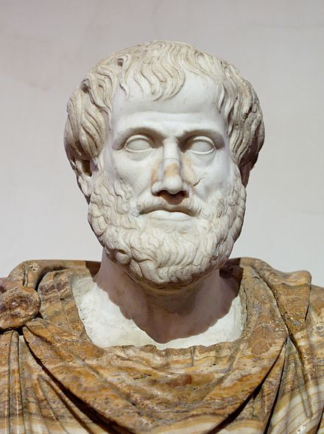
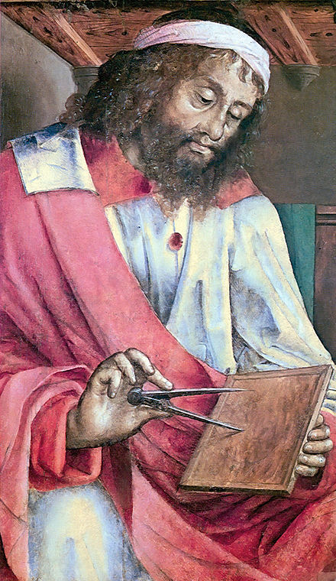
Logics and proofs
Q: How do we know something is true?
A: We prove it
Q: How do we know that we have a proof?
A: We need to know what it means for something to be a proof. First cut: A proof is a “logical” sequence of arguments, starting from some initial assumptions
Q: How do we agree on what is a valid sequence of arguments? Can any sequence be a proof? E.g.
All humans are mortal
All Greeks are human
Therefore I am a Greek!
A: No, no, no! We need to think harder about valid ways of reasoning...
Aristotle
384 – 322 BC
Euclid
~300 BC

Slide 23

The story of logics is quite fascinating
David Hilbert (1862 – 1943)
Gottlob Frege (1848-1925)
first-order logic (∀x. P x /\ R x x)
derive the laws of arithmetic from first principles (Hilbert's 2nd problem)
Bertrand Russell (1872 - 1970)
paradox, inconsistency in Frege's logical system, tried to fix it
Principia Mathematica
Kurt Gödel (1906 - 1978)
incompleteness theorems
Gerhard Gentzen (1909-1945) -- consistency of arithmetic
Alonzo Church (1903 - 1995) -- lambda calculus, simple theory of types
Alan Turing (1912 - 1954) -- undecidability of arithmetic, halting problem
...
Notes:
TODO: not full convinced this was so helpful?

Slide 24

Logics and computer science
Logics is a foundation of mathematics and computer science
precise proofs with respect to valid inference steps/rules
Logics and CS greatly influenced each other, e.g.:
automated theorem provers (e.g., SAT and SMT solvers)
model checkers
proof assistants: Coq, Isabelle, HOL family, F*, ACL2, etc.
interactively constructed, machine-checked proofs
addictive, gamification of proofs

Slide 25
Logics and proofs
Foundation of mathematics and computer science
formal proofs with respect to valid inference steps/rules
This course: typed constructive higher-order logic
higher-order
can quantify not only over individuals (∀x:nat. P x)
but also over propositions (∀P:Prop. P), predicates (∀Q:nat->Prop. Q x), relations (∀R:nat->nat->Prop. R x y), functions (∀f:nat->bool, ∀g:(nat->bool)->bool), ...
constructive, aka intuitionistic logic:
a proposition is valid if one can construct a proof
philosophically rejects excluded middle (P ∨ ¬P, classical logic)
typed (dependently typed)

Slide 26

Verifying realistic imperative programs
the seL4 OS microkernel (Isabelle/HOL), the CertiKOS hypervisor (Coq)
EverCrypt cryptographic library (F*) -- shipping in Firefox and the Linux kernel
EverParse3D verified binary parsers (F*) -- shipping in the Windows kernel
Cătălin, Cezar, et al designing and using F* proof assistant, which combines features of Coq (dependent types) with Hoare Logic verification (Dijkstra monads)
Libjade high-assurance post-quantum crypto library (EasyCrypt, MPI-SP et al)
EasyCrypt proof assistant using Probabilistic Relational Hoare Logic (MPI-SP et al)
Verification of smart contracts (Coq, F*, ...)
Clara, Jana, and their groups at MPI-SP working on this hot topic

